Slide 1
INSTRUCTIONS – WHAT IS THIS SLIDE PACK AND HOW TO USE IT
This pack provides a simple template for an introduction to the G+ Lifesaving Rules.
Please adapt this slide pack for your company’s needs and safety culture
Implementation guidance is available from the G+ website https://www.gplusoffshorewind.com/
Implementing organisations should enhance the slide pack with:
            examples and case studies from their own history,
            relevant for their region and operational risk profile,
            their own roll-out plans

Slide 2
G+ Lifesaving rules
Clear and simple actions to protect our globally expanding frontline
Notes:
Customisable template
This is a title / cover page. Simply add the name of the organisation, person or event and the date.

Slide 3
Why G+ Lifesaving Rules?
        Existing industry lifesaving rules are not adapted to match the offshore wind risk profile → The G+ LSR reflect the G+ data, and focus on hazards in OW environment
        The G+ LSR primarily aims to support those without an existing programme
            The offshore wind industry is expanding globally very quickly, meaning many organisations and the supply chain are at the start of their safety culture journey
For this reason, the G+ chose to have a simplified set of rules, making it easier for the frontline, easier to incorporate in contractual requirements, and easier to align across regions.
They can more readily align at a high level with existing sets among G+ Members, Associates and in the industry, representing a more common denominator
The G+ LSR enables those with existing programmes to:
  validate their programme covers offshore wind specific risk profile,
  refer to the G+ set in discussions with service providers, particularly those new to our industry
Key messages, adapt for own company and align with own vision for the deployment of your lifesaving rules programme.
Create a slide that inspires your audience and underlines your organisation’s commitment to enabling safe working
Notes:
Lifesaving rules that reflect the risk profile of the offshore wind industry, that are as simple and clear as possible, targeted at our rapidly growing industry, with many new entrants with different levels of maturity and different (safety) cultures.

Slide 4

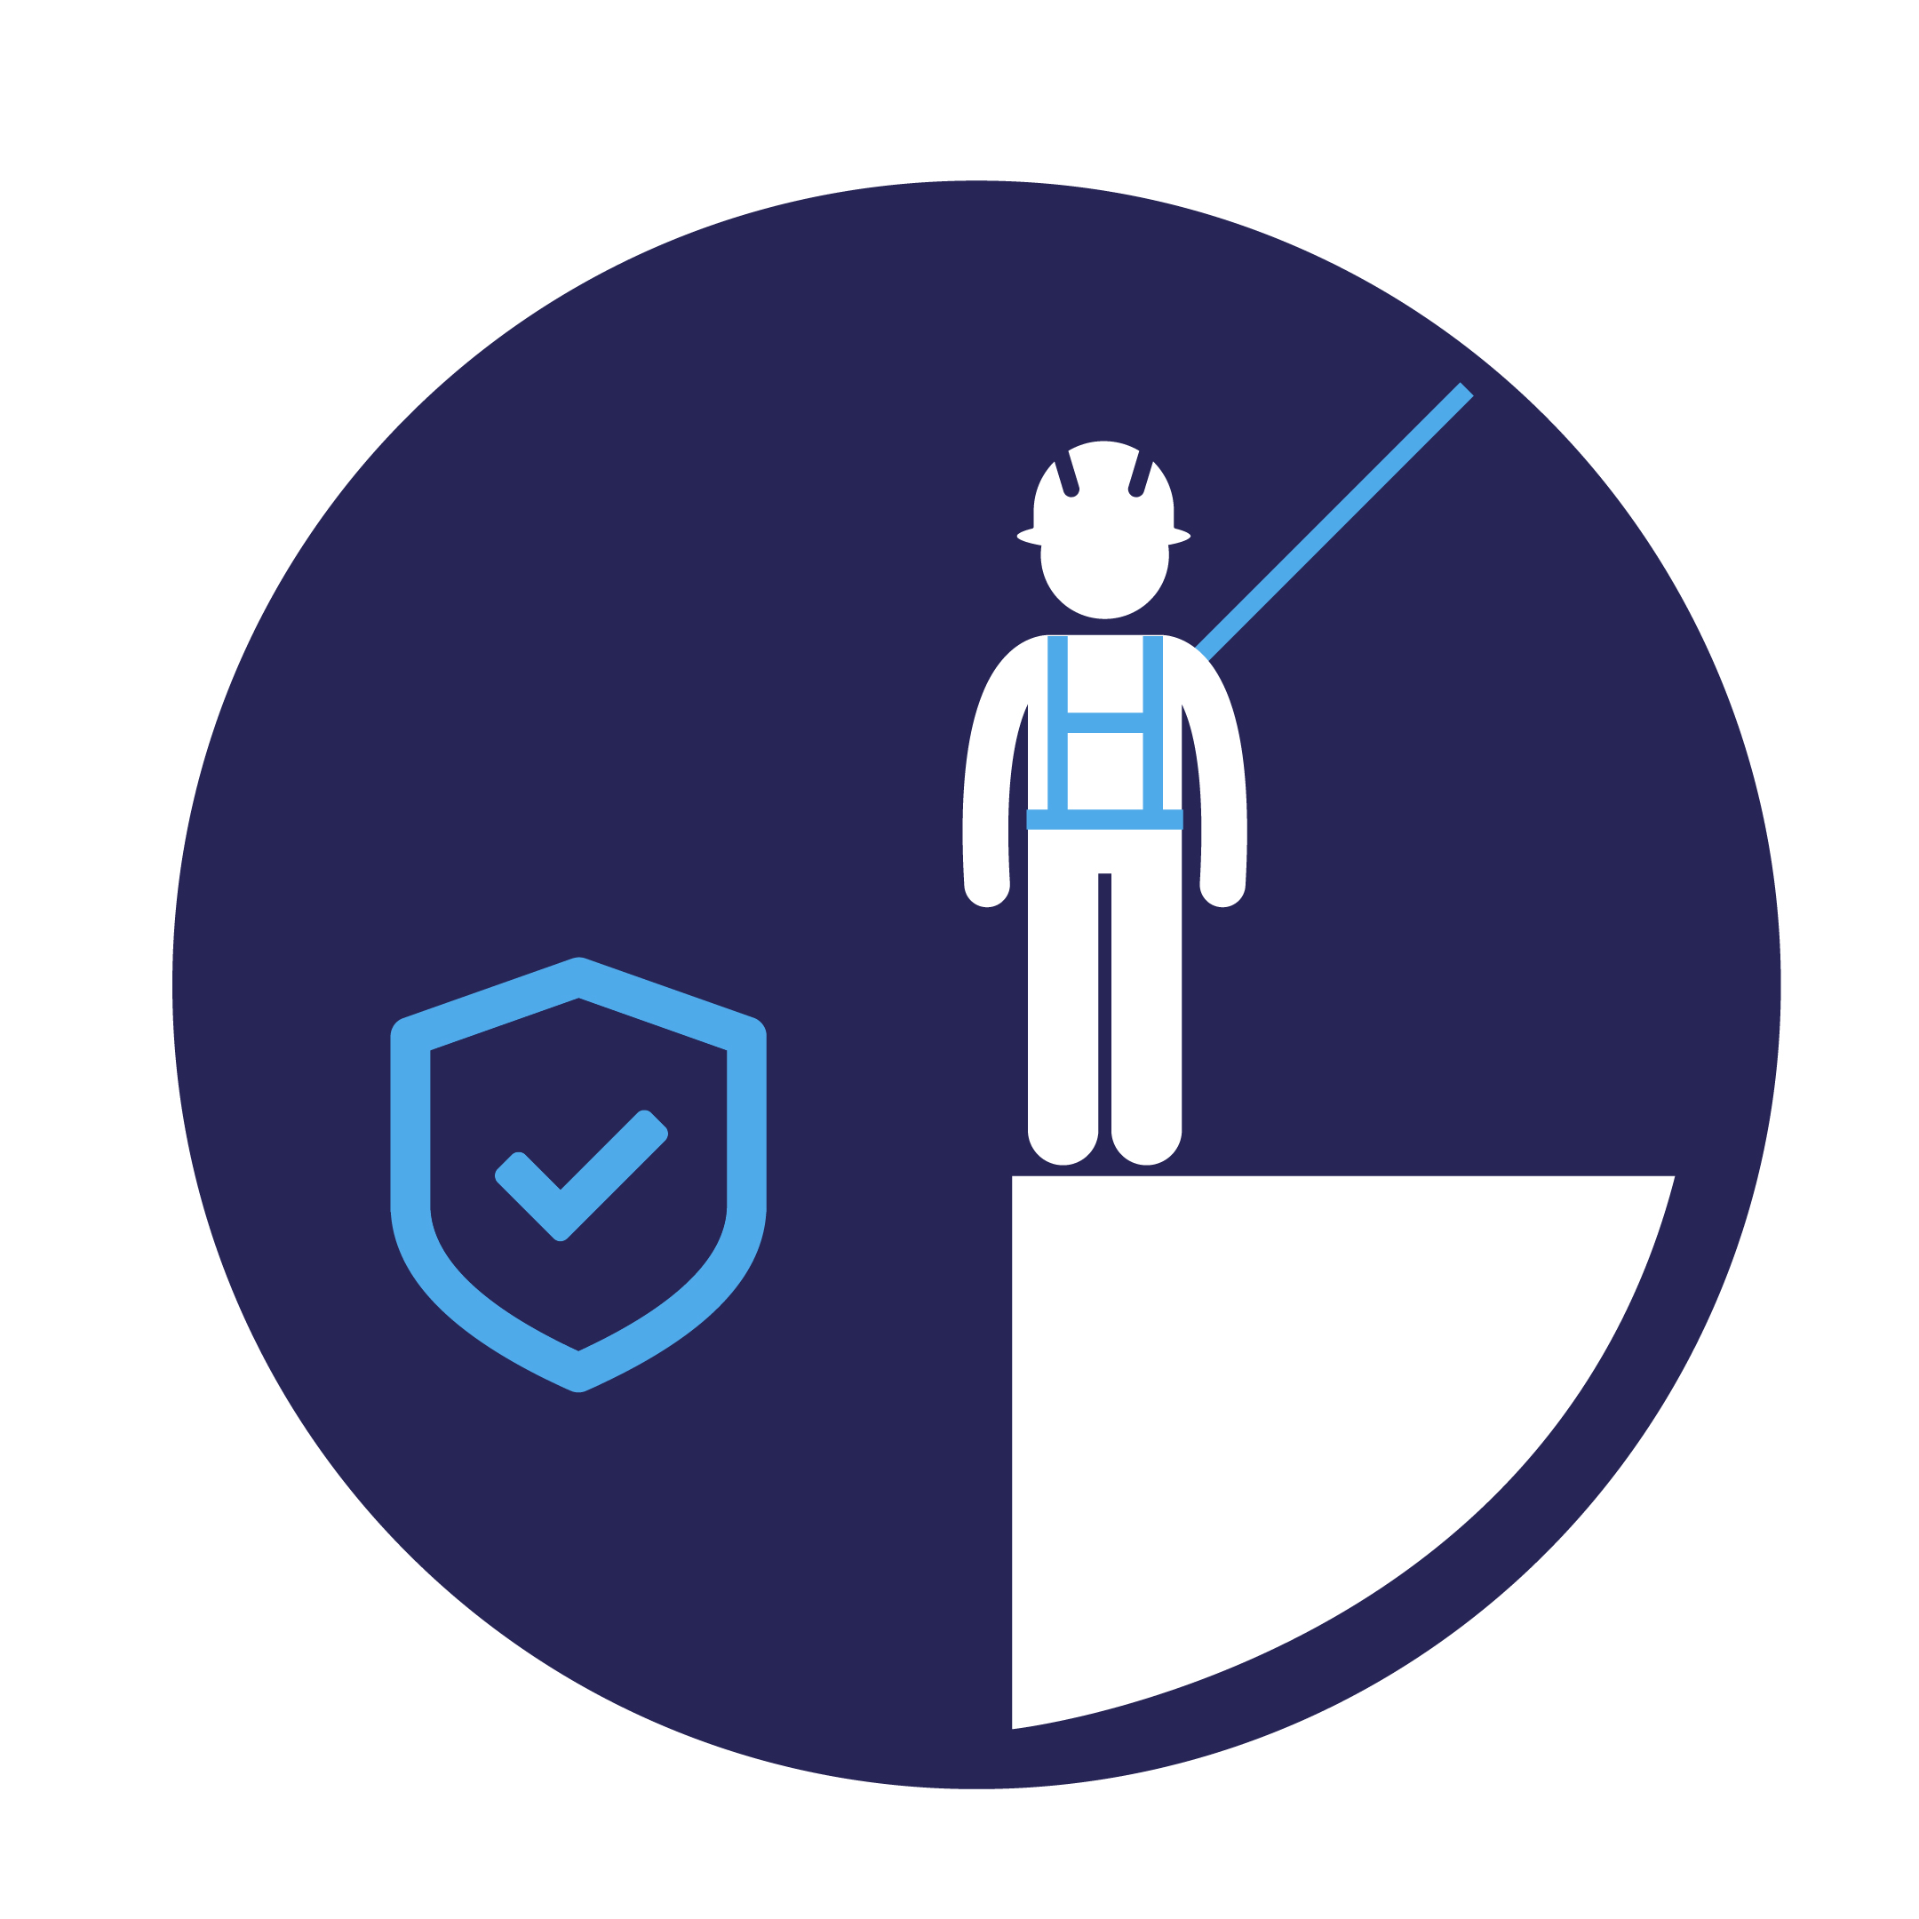



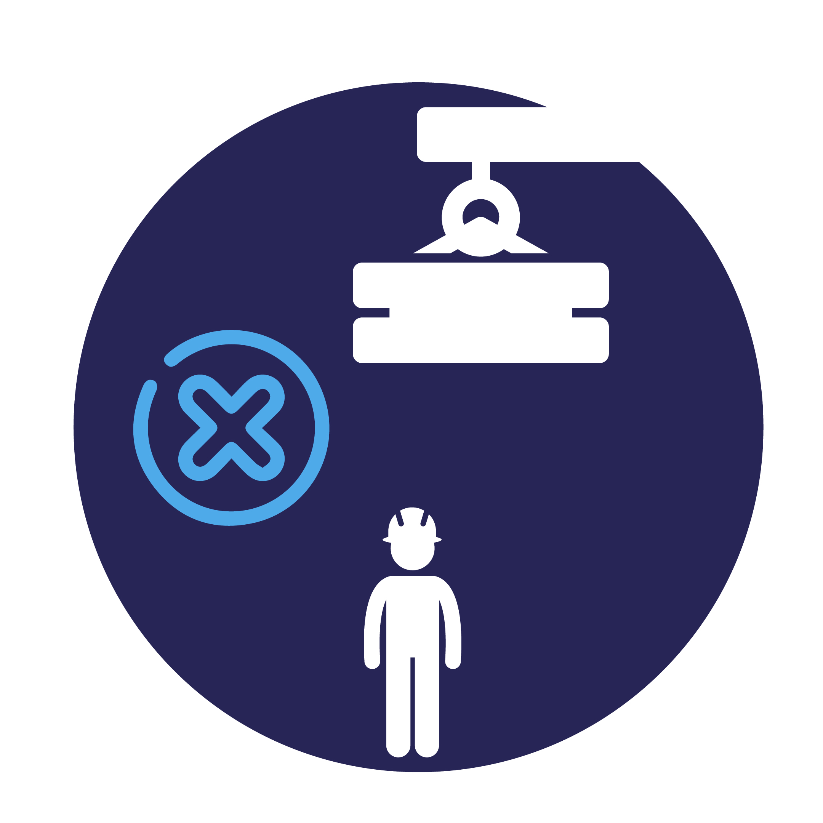

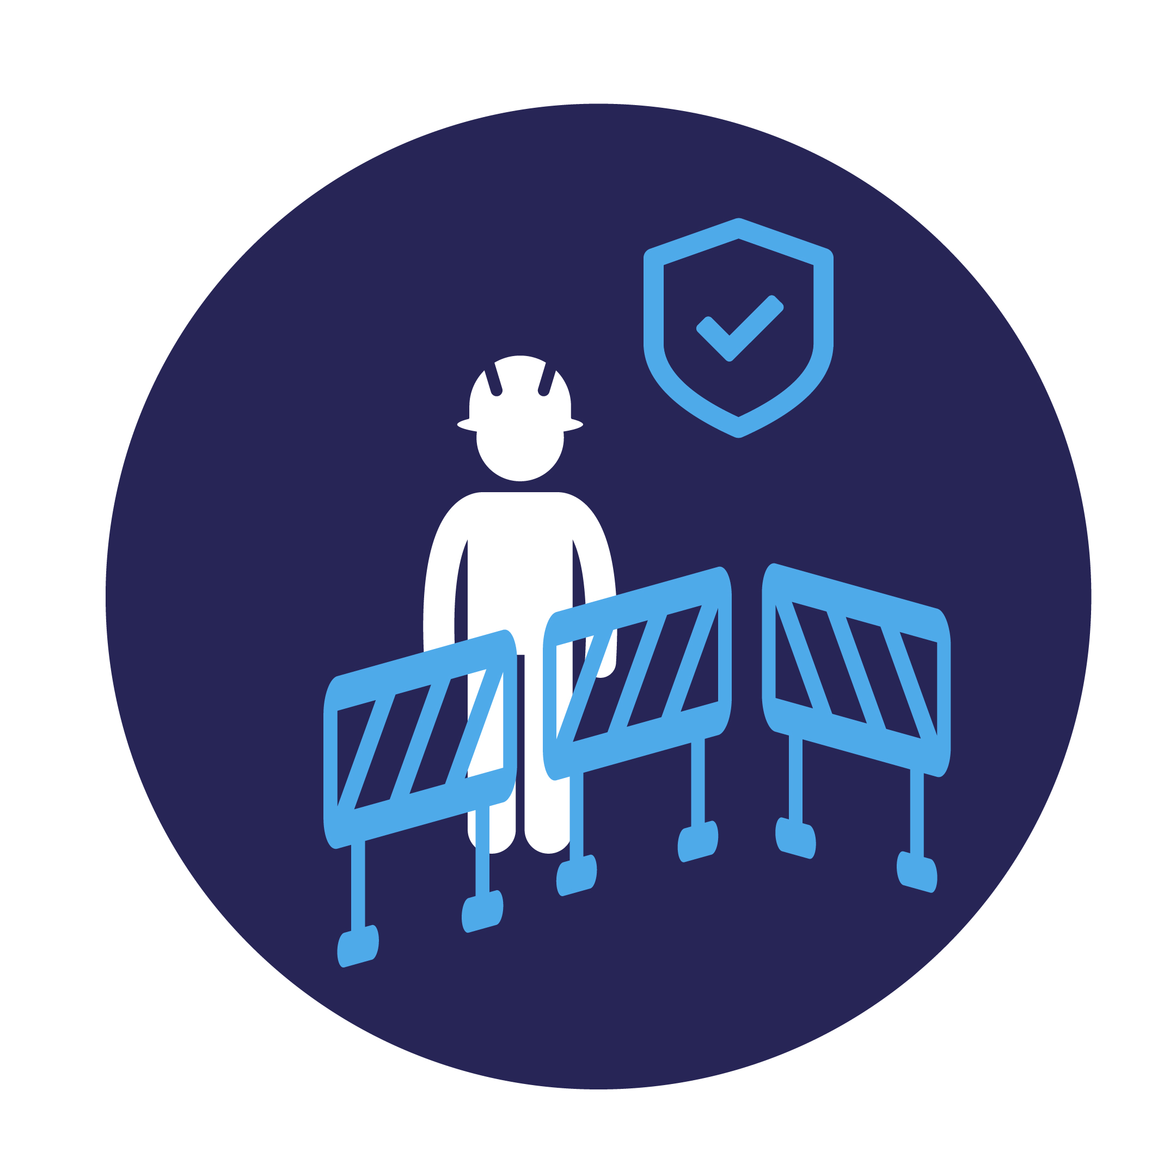

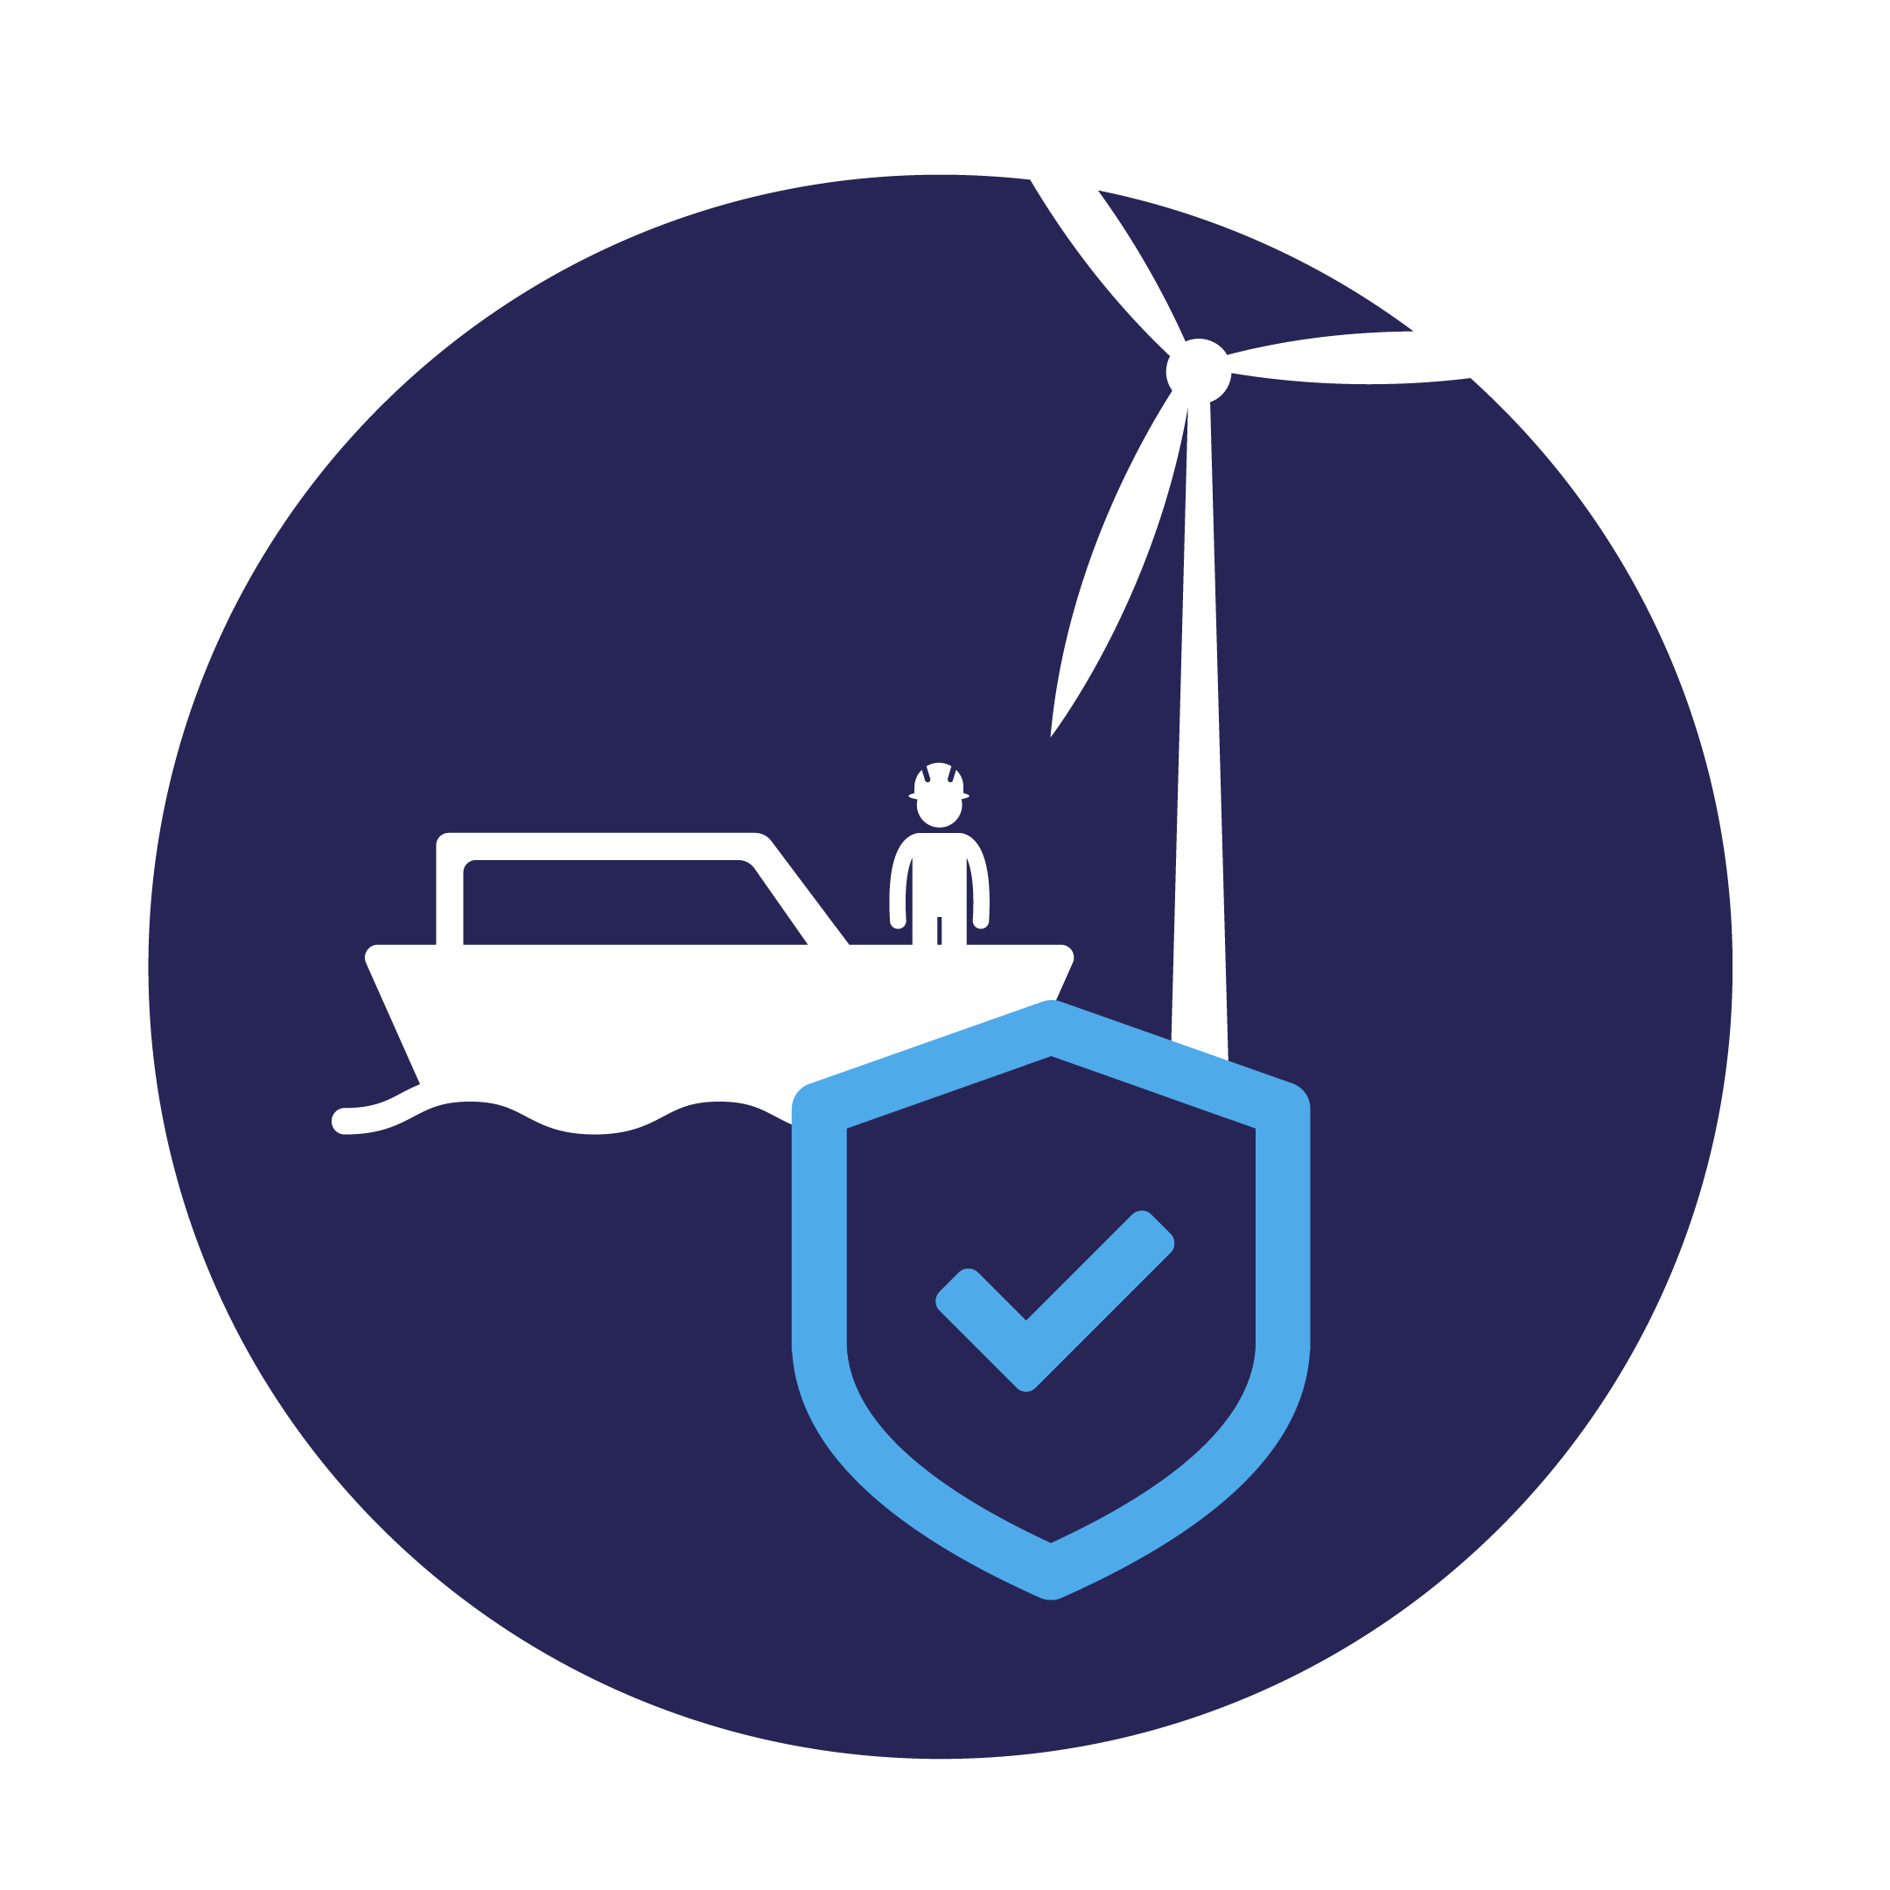
Lifesaving rules for the offshore wind industry
Working Responsibly
Working at Height
Always ensure the required plans and permits are in place before you start a job
Always use tools and equipment that are fit for the intended purpose
Never undertake any job unless you have been trained and assessed as competent
Never work, or operate vehicles or machinery, while under the influence of drugs or alcohol
Always use fall protection when working at height
Out of harms way
Always secure tools, loose materials and equipment to prevent them from falling
Never place yourself under a suspended load during lifting
Always adhere to barriers and exclusion zones
Working with Electricity
Transfer Operations
Always verify isolation and zero energy before work begins
Only transfer from a vessel when you are ready, and permission is provided

Slide 5
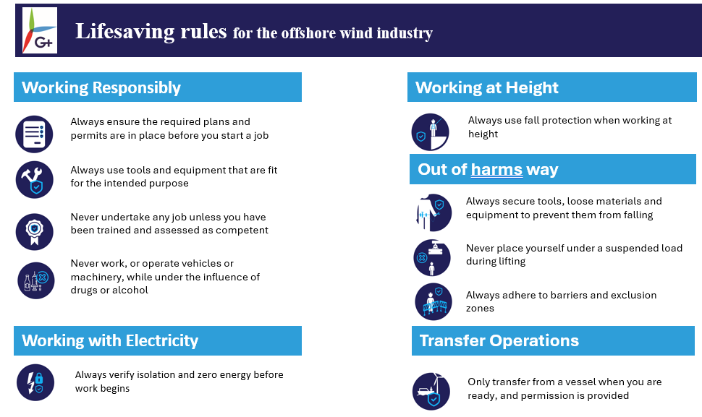





Not just a set of rules
1
2
3
Implementation guidance for companies
Set of Life Saving Rules
Slide packs
Start safe, stop if unsure
4
5
6
Support the front-line
Launch and communication
Monitor and improve
We will collect the data to understand the impact and applicability of the rules, and commit to adapting our rules as needed by the industry.
Ask yourself, your team, your supervisor
Translations coming!

Slide 6
Lifesaving rules for the offshore wind industry
As a company we commit to
Start safe - Work does not start until all team members can confirm that they can follow the relevant Lifesaving rules for the task.
We commit to setting the systems, processes and work-site conditions that enable you to follow the lifesaving rules every day
Stop if unsure - Everyone is encouraged to stop work and seek support when in doubt about the safety of an activity, when conditions change, or work isn’t proceeding as expected.
We commit to listening and acting when you tell us you can’t follow a rule or when something goes unexpectedly

Slide 7
Lifesaving rules for the offshore wind industry
Working Responsibly
Ask yourself, your team, your supervisor
Has the job/task been risk assessed?
What are the required plans and permits for this task? Do we understand them fully?
Have we checked that all the controls described in the plans/permits in place and functioning?
Are the conditions today as expected in the plans/permits (e.g. weather, visibility, correct equipment and tools)?
Is anything today different from usual/unique?
(Especially important for frequently repeated tasks)
How do I tell you if I’m unsure about something when we start, or if conditions change?
How do I Stop The Job?
If we stop the job, how do we leave things in a safe condition?
Always ensure the required plans and permits are in place before you start a job

Slide 8
Lifesaving rules for the offshore wind industry
Working Responsibly
Ask yourself, your team, your supervisor
Do I have all the required PPE, tools and equipment for the task ahead?
Is my PPE rated for the task? (e.g. electrical hazard)
Are my tools and materials rated for the task? (e.g. insulted for working on live electrical systems)
What do I look for when I inspect my tools and equipment?
Where do I take faulty tools or equipment (inc PPE) to be inspected, repaired or taken out of service?
Always use tools and equipment that are fit for the intended purpose

Slide 9
Lifesaving rules for the offshore wind industry
Working Responsibly
Ask yourself, your team, your supervisor
What are the competences required for this task?
I have been trained, but don't have much experience, what exactly am I competent to do?
What am I competent to perform unsupervised?
When do I need to go to refresher training?
If conditions change, do I know the limits of my competence and when I should stop the job?
Never undertake any job unless you have been trained and assessed as competent

Slide 10
Lifesaving rules for the offshore wind industry
Working Responsibly
Ask yourself, your team, your supervisor
How do over the counter or prescription medications affect me? (for example, some medications can make you drowsy)
How is my performance affected in other ways?
(e.g. Do I have enough rest time between work, commuting and home responsibilities?)
Never work, or operate vehicles or machinery, while under the influence of drugs or alcohol

Slide 11
Lifesaving rules for the offshore wind industry
Working with Electricity
Ask yourself, your team, your supervisor
What are all energy sources?
Is the equipment to be worked is correctly identified in the isolation plans or drawings?
Who is responsible for isolating the equipment?
How do I demonstrate the equipment cannot be started?
How do I verify isolation/zero energy state?
Who is responsible for safely re-energising?
How do I communicate with my team?
Always verify isolation and zero energy before work begins

Slide 12
Lifesaving rules for the offshore wind industry
Working at Height
Ask yourself, your team, your supervisor
Have we considered other means of accessing the worksite that would remove a working at heigh?
How do I know my fall protection equipment is certified, inspected, rated and fit for the task?
How do I know I've correctly adjusted the equipment to fit me?
How do I recognise approved anchor points, where I am going to tie-off?
How do I communicate with my team while I'm working at height?
Always use fall protection when working at height

Slide 13
Lifesaving rules for the offshore wind industry
Out of harms way
Ask yourself, your team, your supervisor
Do we have enough securing wire/lanyards/tethers for all the tools and equipment we need?
Do we have enough storage boxes, pouches, bags, etc for all materials at height to be securely enclosed?
How do we identify drop/exclusion zones and control access during work above?
Always secure tools, loose materials and equipment to prevent them from falling

Slide 14
Lifesaving rules for the offshore wind industry
Out of harms way
Ask yourself, your team, your supervisor
How do we adjust the load without going near it/under it?
How do I know if a lifting operation is happening at my worksite?
Are there any SIMOPS?
Never place yourself under a suspended load during lifting

Slide 15
Lifesaving rules for the offshore wind industry
Out of harms way
Ask yourself, your team, your supervisor
How do I recognise a barrier or exclusion zone?
Who can tell me when it's safe to cross?
What are the alternative paths to my destination?
Always adhere to barriers and exclusion zones

Slide 16
Lifesaving rules for the offshore wind industry
Transfer Operations
Ask yourself, your team, your supervisor
How do I know I'm ready?
Am I physically capable to transfer right now?
What signals are we using to communicate?
Am I secure?
Is my equipment secure?
Do I feel safe to transfer?
Only transfer from a vessel when you are ready, and permission is provided

Slide 17
Lifesaving rules for the offshore wind industry
Incident example
Use an example from your own company history and discuss how the could have been rules applied and prevented it, prevented escalation
Alternatively, some incidents shared on ToolBox which are relevant:
transfer related
incorrect use of tools and procedures
Electrical safety
Incident involving davit crane

Slide 18
Lifesaving rules for the offshore wind industry
What is expected of us? Our roll-out plan
Organisations should describe their roll-out plan and what is expected for the specific audience the presentation is being addressed to – e.g. leaders, supervisors, HSE teams should have different roles and responsibilities.
Section 3.3 of the G+ implementation guidance offers some general steps for launch and on-going focus.

Slide 19
Lifesaving rules for the offshore wind industry – SPANISH TRANSLATION
Working Responsibly
Working at Height
Asegúrese siempre de establecer los planes y permisos necesarios antes de comenzar un trabajo
Utilice siempre herramientas y equipos que sean adecuados para el fin previsto
Nunca realice ningún trabajo a menos que haya sido formado y evaluado para ello
Nunca opere ni trabaje con vehículos o maquinaria bajo la influencia de las drogas o del alcohol
Cuando realice trabajos en altura, utilice siempre protección anticaídas
Out of harms way
Asegure siempre las herramientas, los materiales sueltos y los equipos para evitar que se caigan
No se coloque nunca debajo de una carga suspendida durante la elevación
Respete siempre las barreras y zonas de exclusión
Working with Electricity
Transfer Operations
Verifique siempre el aislamiento y la energía cero antes de iniciar el trabajo
Trasládese desde un buque únicamente cuando esté listo y se haya concedido el permiso

Slide 20
Lifesaving rules for the offshore wind industry – CHINESE TRANSLATION
Working Responsibly
Working at Height
在您開始工作之前，請務必確保備妥必要的計畫和許可。
務必使用符合預期用途的工具和設備。
除非您受過訓練並被評估為勝任，否則絕不從事任何工作。
在藥物或酒精的影響下，切勿工作或操作車輛或機械。
在高處工作時，務必使用防墜裝置。
Out of harms way
務必固定工具、鬆動的材料和設備，以防止掉落。
切勿在起重時將自己置於懸掛的裝載物下。
務必遵守障礙物和排除區。
Working with Electricity
Transfer Operations
開始工作前，請務必確認隔離與零能量。
僅在您準備好並獲得許可時從船上轉移。

Slide 21
Lifesaving rules for the offshore wind industry – GERMAN TRANSLATION
Working Responsibly
Working at Height
Vor Arbeitsbeginn sicherstellen, dass die erforderlichen Pläne und Genehmigungen vorliegen
Ausschließlich Werkzeuge und Ausrüstung verwenden, die für den vorgesehenen Zweck geeignet sind
Ausschließlich Arbeiten ausführen, für die man geschult und als befähigt eingestuft ist
Nach Einnahme von Alkohol oder anderen Drogen weder arbeiten noch Fahrzeuge oder Maschinen betreiben
Bei Arbeiten in der Höhe grundsätzlich eine Absturzsicherung verwenden
Out of harms way
Grundsätzlich alle Werkzeuge, losen Materialien und lose Ausrüstung gegen einen Absturz sichern
Beim Heben niemals unter eine hängende Last stellen
Grundsätzlich alle Absperrungen und Sperrbereiche beachten
Working with Electricity
Transfer Operations
Vor Arbeitsbeginn stets sicherstellen, dass die Anlage isoliert und die Elektrik abgeschaltet ist
Von einem Schiff nur dann übersteigen, wenn man bereit ist und wenn die Erlaubnis erteilt wurde

